Slide 1



“SMART HOME AUTOMATION” A MINI PROJECT REPORT submitted by
Padmasree G M (111723102139)
Neha C M (111723102246)
Dandu Bindu Sree (CS241401)
Pranathi N (111723102121)

Slide 2
ABSTRACT.
As our busy lifestyles leave little time for manual management, the concept of home automation has gained traction. This entails using a controller to operate various electronic items in our houses, including fans, LED bulbs, and more. Hence, the aim of this project is to create an efficient and cost-effective home automation system. This system leverages everyday household items like fans and geysers, integrating them into the automation setup. By utilizing a microcontroller and integrating support from programs like IFTTT and Blynk,Cadio, voice commands received by virtual assistants like Siri or Alexa are translated into actions.The presented neurocomputing-based time-series load modeling and forecasting mechanism, facilitated by energy decomposition, is capable of predicting residents’ daily behavioral patterns by non-intrusively analyzing and modeling relevant electrical appliances based on their past trends for smart home automation.

Slide 3
SCOPE OF THE PROJECT
The main goals of technology are to make things easier and more efficient. IoT devices have been given a lot of prominence in today’s popular culture. Because automation requires less work and is more effective, we can successfully operate appliances in many different locations by utilizing IoT. The scope of the project includes designing and implementing an efficient and pocket-friendly home automation system using everyday household items like fans and geysers. To ensure cost-effectiveness, the project will focus on utilizing readily available components and minimizing the overall investment required. The implementation will also take into consideration the ease of installation and usability, ensuring that users can easily set up and interact with the home automation system.Overall, the project aims to create a practical, affordable, and user-friendly home automation solution that enhances convenience and efficiency for users in managing their household appliances.

Slide 4
THE PROBLEM STATEMENT
Most conventional prepaid power meters currently installed in households only display the total real-time usage of power and the amount of electricity available. There is no way to see what the day’s, week’s, or month’s consumption was on these meters, and often these power meters are placed in inconvenient locations, making regular viewing somewhat difficult. These power meters also lack the ability to monitor appliances individually, thus hiding vital information about individual appliances.

Slide 5
SOLUTION
A Smart Meter System is required to analyze multiple household appliances, obtaining readings such as voltage, current, active power, apparent power, reactive power, power factor, and frequency. Using a wired or wireless connection, the device can connect to a central gateway, where the gathered information is uploaded and processed by the gateway management system. The data can then be displayed on the platform’s graphical Android-based user interface, accessible from any Android-enabled device. To reduce costs, the system will use energy metering nodes that communicate with the gateway wirelessly or via wired connections, requiring only one Wi-Fi access point for a household with many monitored appliances. Additionally, current information about the appliances can be viewed on a local display with a menu interface.

Slide 6
EXISITING SYSTEM
The existing home automation system uses various devices and techniques to operate home appliances, including PCs, laptops, wireless switches, and smartphones as control interfaces. Techniques like Zigbee, Bluetooth, ARM9, SMS, and Android ADK are adopted for implementation. Users can control and manage appliances remotely through different interfaces, such as a graphical user interface (GUI) or web-based interface on a PC or laptop. These interfaces allow users to send commands to turn appliances on/off, adjust settings, or schedule operations. Wireless switches provide a physical means of control, strategically placed around the home for convenience. Smartphones serve as portable control devices, playing a crucial role in the system

Slide 7
LITERATURE SURVEY:
Anjum Ara, Shivkumar Jawaligi “ Literature survey on IOT and Smart grid”
Paper got published in 2019
With a constant development in technology, voice command systems such as Amazon Alexa and Apple’s Siri is becoming a more natural part of standard living. We saw many home automation technologies introduced over these years from Zigbee automation to Amazon Echo, Google Home and Home from Apple. It has become a craze these days. The expense of these gadgets is more with an extra expense of the devices to be associated with. So, overall we can see here that to make our home smart we have to contribute a considerable amount, for a basic setup. Imagine a scenario where we can automate our home with low cost and can control up to 9 appliances utilizing Google Assistant. Indeed, this projet portrays the usage of such a framework.

Slide 8
Shaik Mulla Shabber2 iHAS : “An Intelligent Home Automation Based System for Smart City”
Paper got published in 2021
Abstract: Nowadays, people are looking for methods to improve their lifestyles by utilising the latest technologies accessible. Various home automation system have grown in popularity over the last decade, and it improves comfort and quality of life. The proposed work explores an intelligent home automation system (iHAS) that allows the user to monitor electrical appliances of the home from everywhere in the world. This system can be used to describe how all home appliances function together and control them using the laptop, Android smartphone, or tablet with internet access. The home automation system can be installed in existing home environments without requiring any infrastructure changes. This paper explored the design and implementation of an individual control home automation device utilising Wi-Fi enabled micro-controller unit. The user can have complete control over the home appliances and devices from anywhere using only an Android app and an internet connection.

Slide 9
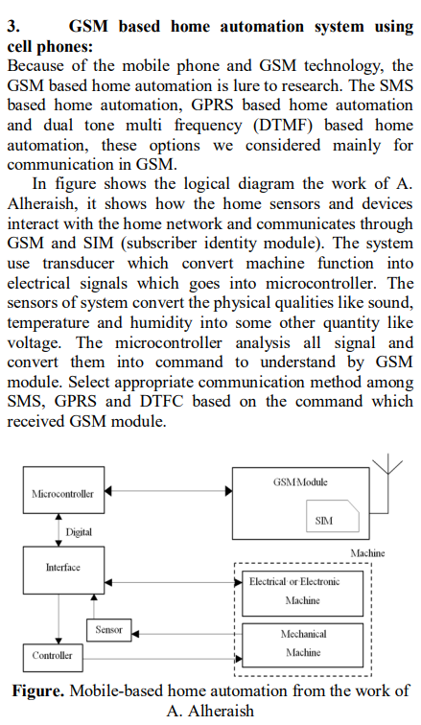

Slide 10
Rajesh Rishi and Pinki[4] : “Automation of Smart Home using Smart Phone via Google Assistant”
Paper got published in 2021
Abstract: The main objective of this system is to automate every connected device by use the interface which are the AI and the application program designed purposely for the technology. It is as easy as it only requires to press a button or give a command through the arbitrary system. With technology advancing in this era houses, offices, workplaces or any other place where there is a roof, they are becoming smarter and smarter. Present day homes are gingerly transitioning from traditional control to a more consolidated directed arrangement, involving wireless data transfer through mobile device, smart phones which has specifically in-built interface to interact with it. Current, ordinary and standard home switches established in contrasting parts of the house contribute to its difficulty that adds to the user using it to go close to them for it to operate. The physically impair persons who are put at an advantage due to their disorder sees it strenuous to perform these measures. Secluded administered home automation system technology come up with a most ingenious remedy with intellect phones. This is achieved through effective data and particulars distribution to the controller which fundamentally and indubitably present the adequate results to the components with which the user wants to have interchange of information with. This interplay with the particulars such as the strings sent over a networking protocol achieve the appropriate outcome with when the process will pull of the requisite consequence and effect the person using it desires.

Slide 11
By Mummaka Sai Srinath ,Manepalli Nanda Kishore ,M.D. Anto Praveen [5] “Enhanced
Smart Home Automation System based on Internet of Things”
Paper got publish in 2018
Abstract : This is an interactive home automation system that is unique in its own way that it is unlike any other existing home automation systems that have been made previously. Most of the existing systems that are available in the market use a Raspberry Pi or Arduino chipset that are programmed to control a set of devices inside a house, which are given instructions using a mobile application or a web-based UI. Unlike them, this device focuses on controlling the devices using voice recognition and artificial intelligence, while being interactive as well. This is achieved by utilizing the open sourced API of Google Assistant by Google Inc

Slide 12
Mr. Prashanth Kusuma, Ms. P. Bhavya Shri [6] “Smart Home Systems: Overview and Comparative Analysis” By Mr. Kalyan Chenumalla, Mr. Srikanth Gottam,
Paper got published in 2019
Abstract: The idea behind Google assistant-controlled Home automation is to control home devices with voice. On the market there are many devices available to do that, but making our own is awesome. In this project, the Google assistant requires voice commands. Adafruit account which is a cloud based free IoT web server used to create virtual switches, is linking to IFTTT website abbreviated as “If This Than That” which is used to create if else conditional statements. The voice commands for Google assistant have been added through IFTTT website. In this home automation, as the user gives commands to the Google assistant, Home appliances like Bulb, Fan and Motor etc., can be controlled accordingly. The commands given through the Google assistant are decoded and then sent to the microcontroller, the microcontroller in turn control the relays connected to it. The device connected to the respective relay can be turned On or OFF as per the users request to the Google Assistant. The microcontroller used is NodeMCU (ESP8266) and the communication between the microcontroller and the application is established via Wi-Fi (Internet).

Slide 13
Thanikonda Madhuri, Mullamuri Anjali, Navya U, Mandadi Venkata Sindhuja, Prof. Mr. Rajgopalan
“[7]HOME AUTOMATION USING IOT”
Abstract: The modern world is moving fast then our older world invention of high tech appliances has revolutionized our whole world and it has also sprouted the idea towards automation. Human lifestyles have been much easier thanks to the tv remotes we have had for our tv and many other electrical gadgets today. How many of you have considered automating home, that could allow you to use a controller to operate fan, led bulbs, as well as other electronic items in your house? Because humans have little time to manage any work, automating appliances is a quick and easy technique to manage any instrument or gadget that will perform as we want. As idea of automation is rapidly developing, we have seen a number of domestic automation technologies emerge over the years, like Home for Apple, Google Home, Amazon Echo, and zigbee automation and we can see many startups are working on it . The above technology makes our homes smarter, but they require a significant investment. So, the target of the project would be to put a efficient and pocket friendly home automation program in place.By bringing into use the day to day household items like fans and geaser this system is implemented. With the help of microcontroller and special support from IFTTT and blynk programmes the voice commands which siri recieves or alexa are translated. w hen necessary, the relays attached to appliances are controlled by microcontroller, which switches the connected device to each relay ON or OFF in accordance with the customer's request to Voice Assistants.The NodeMCU [ESP8266] microprocessor is employed, and Wireless Fidelity is used to establish connection with both the microprocessor as well as the applications. Keyword: IFTTT, NodeMCU, Relay Module, and Blynk. I. INTRODUCTION 21st century is the era of convenient, comfortable, secure and economical appliances

Slide 14
[8]Bluetooth based home automation system using cell phones:
In Bluetooth based home automation system the home appliances are connected to the Arduino BT board at input output ports using relay. The program of Arduino BT board is based on high level interactive C language of microcontrollers; the connection is made via Bluetooth. The password protection is provided so only authorized user is allowed to access the appliances. The Bluetooth connection is established between Arduino BT board and phone for wireless communication. In this system the python script is used and it can install on any of the Symbian OS environment, it is portable. One circuit is designed and implemented for receiving the feedback from the phone, which indicate the status of the device.

Slide 15
[9] Home automation using RF module:
The important goal of Home Automation System is to build a home automation system using a RF controlled remote. Now technology is accelerating so homes are also getting smarter. Modern homes are deliberately relocating from current l switches to centralized control system, containing RF controlled switches. Todaytraditional wall switches situated in various parts of the home makes it laborious t for the end user to go near them to control and operate. Even further itturnsinto moreproblematic for the old persons or physically handicapped people to do so. Home Automation using remote implements an easier solution with RF technology. In order to accomplish this, a RF remote is combined to the microcontroller on transmitter side that sends ON/OFF signals to the receiver where devices are connected. By operating the stated remote switch on the transmitter, the loads can be turned ON/OFF globally using wireless technology.

Slide 16
[10]. Raspberry pie home automation with wireless sensors using smart phone Home Automation System has been developed with Raspberry Pi by reading the algorithm and subject of Email. Raspberry Pi guarantees to be an efficient platform for implementation powerful, and economic smart home automation. home automation using Raspberry pi is better than any other home automation methods in several ways. For example, DTMF (dual tone multi-frequency) using home automation, the call tariff is a big demerit, which is not the problem in their proposed method. In Home Automation using web server, the design of web server and the memory space required is dismiss by this method, because it just uses the already established web server service given by G-mail. LEDs were used to identify the switching action. This System is efficient and flexible interactive.

Slide 17
[11]. Wireless Home Automation system using IoT
This system uses mobiles or computers to control basic home control and function automatically through internet from anywhere around the worldglobally, an automated home is sometimes called a smart home. It is meant to save the electric power and human energy. The proposed system is a distributed home automation system, consists of server i.e. Wi-Fi module, sensors. Server controls and monitors the various sensors, and can be easily configured to handle more hardware interface module (sensors). The Arduino board, with built in Wi-Fi module acts as web server. Automation System can be accessed from the web browser of any local PC using server IP, or remotely from any PC or mobile handheld device connected to the internet with appropriate web browser through server real IP (internet IP). Wi-Fi technology is selected to be the network infrastructure that connects server and the sensors. Wi-Fi is chosen to improve system security (by using secure Wi-Fi connection), and to increase system mobility and scalability.

Slide 18
[12]Home Automation System Neha Malik1 , Yogita Bodwade1 Government College of Engineering, Jalgaon, India1
Abstract:
One of the topics which is gaining popularity is Home Automation System because of itsinnumerous advantages. Home automation refers to the monitoring and controlling of home appliances remotely. with the neverending growth of the Internet and its applications, there is much potential and scope for remote access and control and monitoring of such network enabled appliances. This paper deals with discussion of different intelligent home automation systems and technologies from a various features standpoint. The effort targeted on the home automation concept of where the controlling and monitoring operations are expediting through smart devices. Wide-ranging home automation systems and technologies considered in review with central controller based (Arduino or Raspberry pi), cloud-based, Bluetooth-based, SMS based, ZigBee based, mobile-based, RF Module based, web based and the Internet with performance.

Slide 19
Lokesh Varshney [13] “Literature Review on Home Automation System”
Abstract:
One of the topics which are gaining popularity is Home Automation System because of its numerous advantages. Home automation refers to the monitoring and controlling of home appliances remotely. Due to never ending growth of the Internet and its applications, there is much potential and scope for remote access, control and monitoring of such network enabled appliances. A home automation system means to grant the end-users to manage and handle the electric appliances. If we look at different home automation systems over time, they have always tried to provide efficient, convenient, and safe ways for home inhabitants to access their homes. This paper deals with discussion of different intelligent home automation systems and technologies from a various features standpoint. The effort targeted on the home automation concept of where the controlling and monitoring operations are expediting through smart devices. Wideranging home automation systems and technologies are considered in review with central controller, cloud-based, Bluetooth-based, SMS based, ZigBee based, mobile-based, RF Module based, web based and the Internet with performance. Keywords: Home Automation, Intelligence, Microcontroller, Raspberry pi, Sensor System, User-friendly Interface.

Slide 20
Ranjeeta Kaur; Prashant Vats; Manju Mandot; Siddhartha Sankar Biswas;
[14] ”Literature Survey for IoT-based Smart Home Automation: A Comparative Analysis”
Abstract:
Any technology that allows a gadget to connect to the Internet is referred to as the “Internet of Things.” For such systems, data collection is crucial. Afterward, the data is used for internet-based control, monitoring, and data transmission to other devices. Smart House technology is the future of domestic technology, with the goal of offering and distributing a range of services both within and outside the home via networked devices that combine and integrate all of the many applications and intelligence behind them. These smart gadgets have the capacity to communicate with one another thanks to the continual availability of a broadband internet connection. As a result, smart home technology is now integrated into the Internet of Things (IoT). We provided a literature review on Smart Home Automation in this research study, which gives homeowners peace of mind by allowing them to monitor and protect their houses from away.

Slide 21
Prachi SharmaNSUT
Vibha JainNSUT [15]Smart Home Automation: Literature Review
Poonam RaniNetaji Subhas Institute of Technology (NSIT) – “Netaji Subhas University of Technology”
Date Written: July 12, 2021
Abstract
Home automation systems are nowadays becoming very popular and gaining lots of attention. It helps a person to be more comfortable. It has also enhanced the quality of life. Di erent methods are discussed. Nowadays, a smartphone or a website is used to assist, control and manage the devices present in the home. This paper shows various types of methods. The pros and cons of these along with their features have been discussed A person can choose a specic method based on their requirements.

Slide 22
PROPOSED SYSTEM
The proposed system enhances the existing home automation setup by integrating a Wi-Fi module with various sensors for wireless data transmission. The system uses the Cadio application and the Wi-Fi module to receive sensor data and provide monitoring capabilities. The Wi-Fi module connects to sensors like temperature, motion, and humidity sensors, enabling real-time monitoring and analysis of environmental conditions within the home. The Cadio application serves as a user-friendly dashboard to monitor and visualize sensor data, allowing users to make informed decisions.Additionally, the Cadio application implements an automatic switch between two sources, such as power sources (electricity and backup generators) or internet service providers (ISPs), based on predefined criteria. This ensures a seamless transition without manual intervention.

Slide 23
IDEA- CURRENT STATUS/ FUTURE PLAN
There are a variety of enhancements that could be made to this system to achieve greater accuracy in sensing and detection:
a) There are many other sensors that can be used to increase the security and control of the home, such as pressure sensors that can be placed outside to detect when someone is about to enter.
b) The future scope for home automation systems involves making homes even smarter.
c) Homes can be interfaced with sensors, including motion sensors, light sensors, and temperature sensors, to provide automated toggling of devices based on conditions.

Slide 24
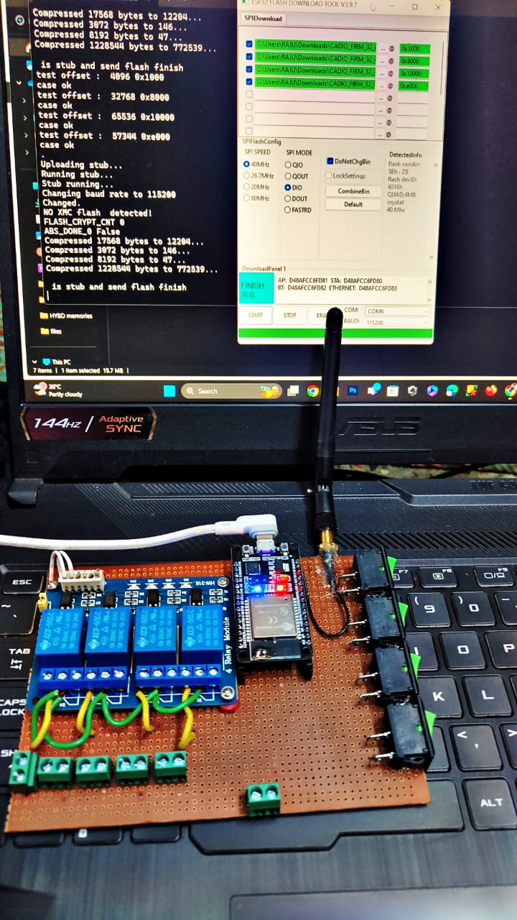
SAMPLE VIEW OF OUR PROJECT

Slide 25
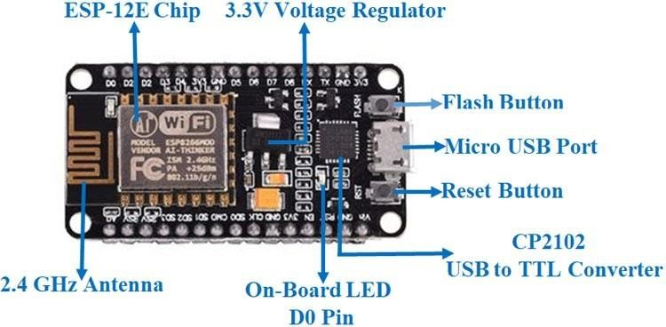
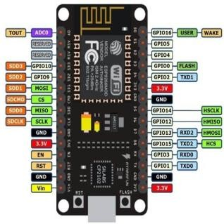
HARDWARE AND SOFTWARE USED
NODE MCU

Slide 26
HARDWARE:
Node MCU
Relay module
Power supply Bulb
Jumper wires
Antenna
Mother Board
Software:
Arduino ide
Cadio application
Portronics

Slide 27
CONCLUSION AND FUTURE SCOPE
In this project, voice commands are given to Google Assistant. The voice commands for Google Assistant have been added through the IFTTT website, and the Cadio app is also linked to it. In this home automation system, users give commands to Google Assistant, and LEDs are controlled according to the given commands. This project is about wireless home automation using an Android mobile, helping us implement such a fantastic system in our home at a very reasonable price using cost-effective devices.Thus, it overcomes many problems like costs, inflexibility, and security. Additionally, it provides greater advantages, such as decreasing our energy costs and improving home security. It is very convenient to use and will improve the comfort of our home. The project proposes the idea of smart homes that can support a wide range of home automation systems

Slide 28
ADVANTAGES
Easy deployment, installation, and coverage.
Reduced installation costs.
System scalability and easy extension.
4) Integration of mobile devices

Slide 29
REFERENCE
[1]. Mummaka sai Srinath, Manepalli Nanda Kishore, ‘Interactive home automation system with google assistant’, International Journal of pure and applied mathematics,Year:2018,Volume 119, No.12.
[2]. Madhuri Das, ‘Home Automation Using ESP8266’,Transaction on machine design,Year:2018,Volume 06,No.02.
[3]. Anjum Ara, Shivkumar Jawaligi,‘NodeMCU(ESP8266) control home automation using google assistant’, International research journal of engineering and technology,Year:2019,Volume:06,Issue:07.
[4]. Mr. Kalyan Chenumalla, Mr. Srikanth Gottam, Ms.p.Bhavya Shri, ‘Google Assistant Controlled Home Automation’, IEEE VEC SB,Year:2019.
[5].RajeshRishi, PinikDoloi, ‘Home automation using google assistant’, International journal of innovative research in electrical, electronics, instrumentation and control engineering,Year:2021,Volume:09,issue:06.
[6] Hittu Garg, Mayank Dave ,‘Securing IoT Devices and SecurelyConnecting the Dots Using REST API and
Middleware ’ 2019 4th International Conference on Internet of Things: Smart Innovation and Usages (IoT-SIU)
Year :2019
[7] C. Wang, G. Yang, G. Papanastasiou, H. Zhang, J. Rodrigues, and V. Albuquerque,
‘‘Industrial cyber-physical systems-based cloud IoT edge for federated heterogeneous
distillation,’’ IEEE Trans. Ind. Informat., early access, Jul. 7, 2020, doi:
10.1109/TII.2020.3007407.
38

Slide 30
[8] A. M. Elmisery, M. Sertovic, and B. B. Gupta, ‘‘Cognitive privacy middle
ware for deep learning mashup in environmental IoT,’’ IEEE Access, vol. 6, pp. 8029–
8041, 2018.
[9] F. Montori, L. Bedogni, and L. Bononi, ‘‘A collaborative Internet of Things
architecture for smart cities and environmental monitoring,’’ IEEE Internet Things J.,
vol. 5, no. 2, pp. 592–605, Apr. 2018.
[10] B. Keswani, A. G. Mohapatra, A. Mohanty, A. Khanna, J. J. P. C. Rodrigues, D.
Gupta, and V. H. C. de Albuquerque, ‘‘Adapting weather conditions based IoT
enabled smart irrigation technique in precision agriculture mechanisms,’’ Neural
Comput. Appl., vol. 31, no. S1, pp. 277–292, Sep. 2018.
[11] L.-M. Ang, K. P. Seng, A. M. Zungeru, and G. K. Ijemaru, ‘‘Big sensor data
systems for smart cities,’’ IEEE Internet Things J., vol. 4, no. 5, pp. 1259–1271, Oct.
2017.
[12] J. Santos, T. Vanhove, M. Sebrechts, T. Dupont, W. Kerckhove, B. Braem, G. V.
Seghbroeck, T. Wauters, P. Leroux, S. Latre, B. Volckaert, and F. D. Turck, ‘‘City of
things: Enabling resource provisioning in smart cities,’’ IEEE Commun. Mag., vol. 56,
no. 7, pp. 177–183, Jul. 2018.
[13] K. Pardini, J. J. P. C. Rodrigues, O. Diallo, A. K. Das, V. H. C. de Albuquerque,
and S. A. Kozlov, ‘‘A smart waste management solution geared towards citizens,’’
Sensors, vol. 20, no. 8, p. 2380, Apr. 2020.

Slide 31


